Slide 1
IoT utilization of Raspberry Pi
By Isak Skeie

Slide 2
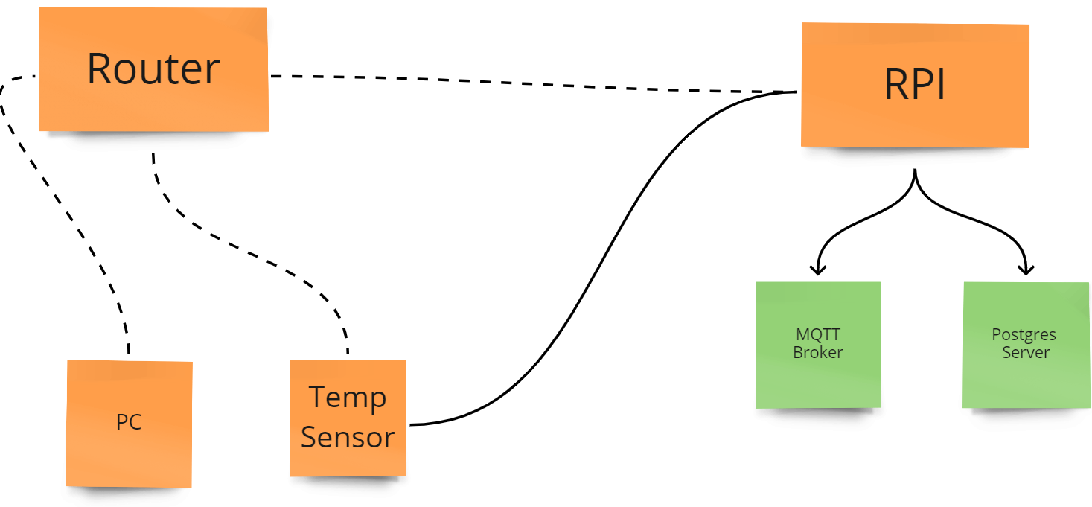
Project Overview

Slide 3
Development Tools and Hardware Hardware Software
Raspberry Pi 4 b+
ESP32 microcontroller
Thermistor
DS18B20 temperature sensor
Router
PC
Python
Visual Studio Code
Platform IO
SSH
Mosquitto MQTT broker
Postgress DB server
ThingSpeak

Slide 4
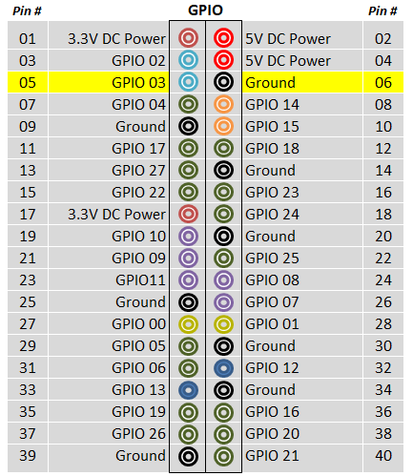
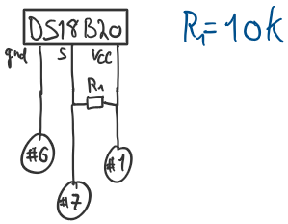
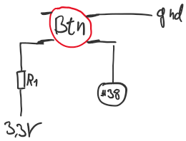
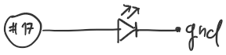
Raspberry Pi wiring

Slide 5
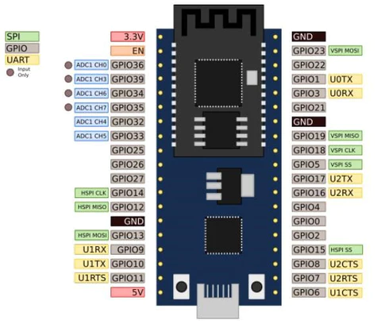
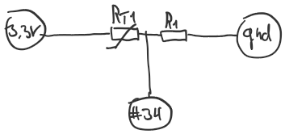
ESP32 Wiring

Slide 6
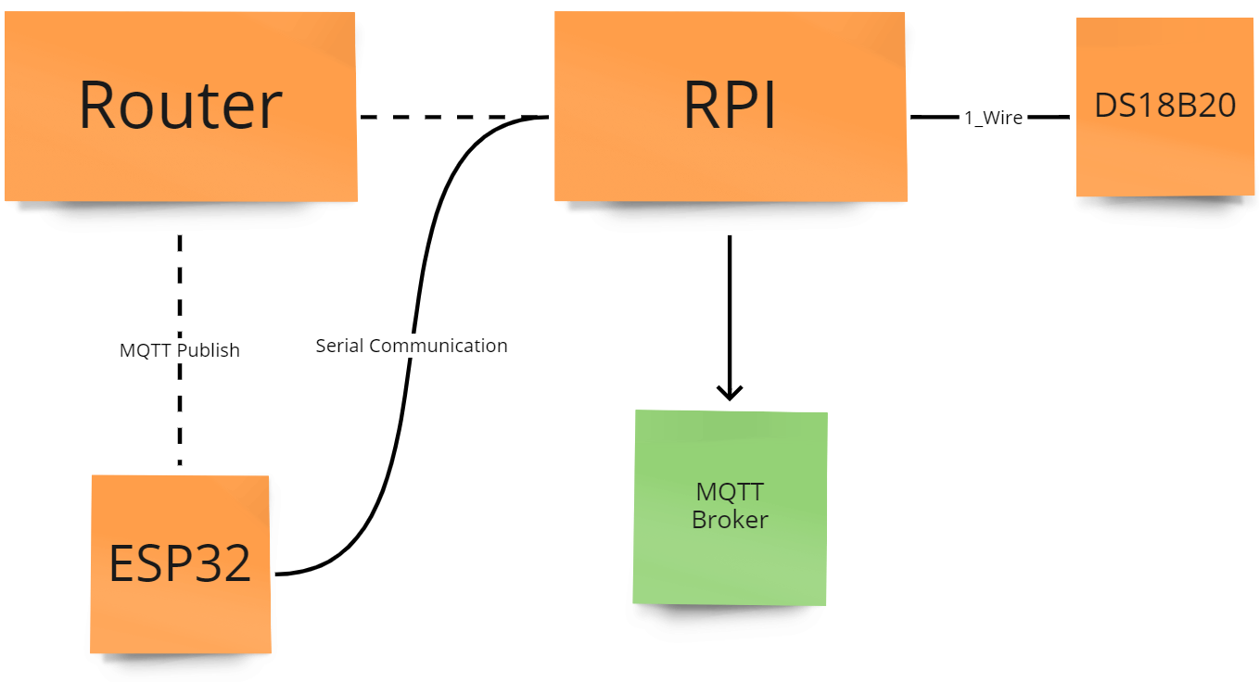
Temperature Handling
DS18B20 through 1-Wire with python
ESP32 with Thermistor
Serial Communication
MQTT Publish
LowPass filter

Slide 7
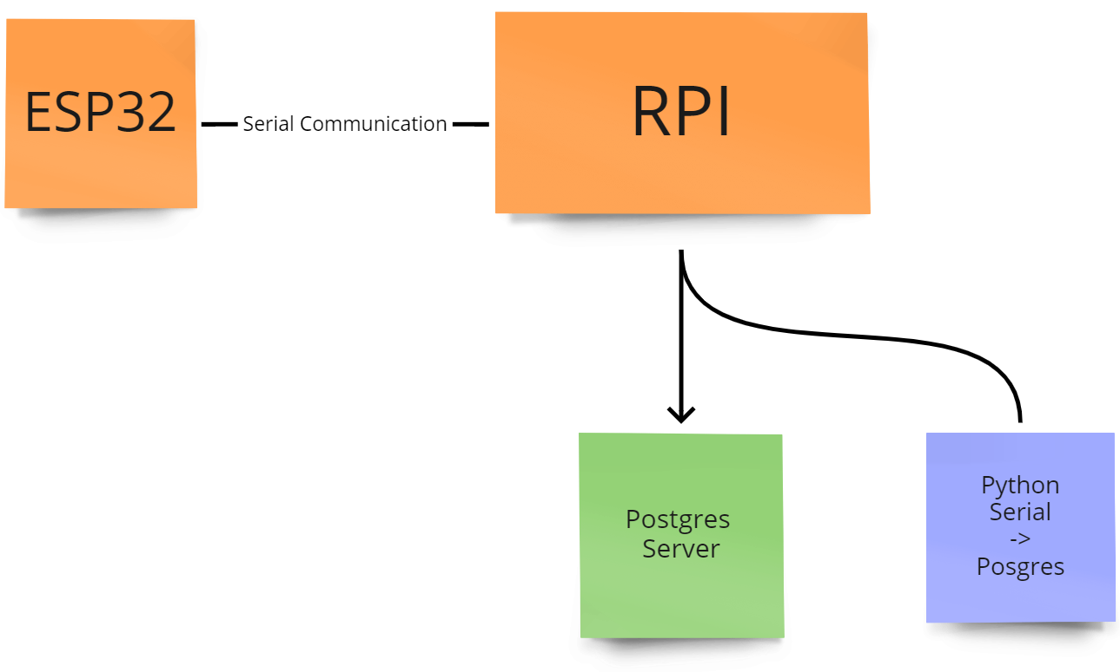
Alarm handling and Postgres DB
From Thermistor through ESP32
Serial to RPI
Postgres DB runs on RPI
RPI Python script
Sets LED high for alarm
Lowers brightness when not active
Turns off when ack.
DB stores temp and Alarm states

Slide 8
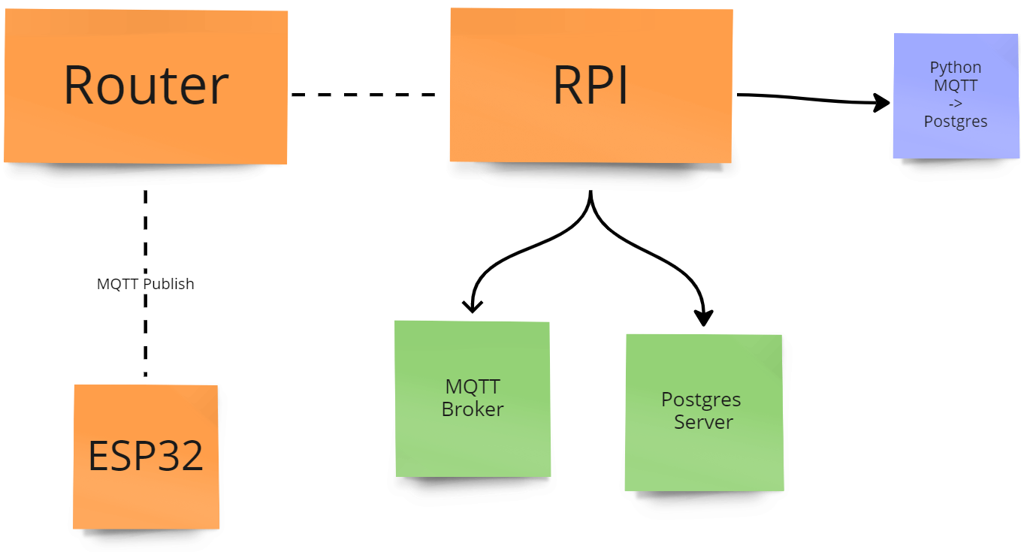
MQTT broker and Thinspeak
Same temp data through MQTT
Local MQTT broker
Data management
Python script
MQTT Subscribe
DB insert
Python script uploads to ThingSpeak

Slide 9
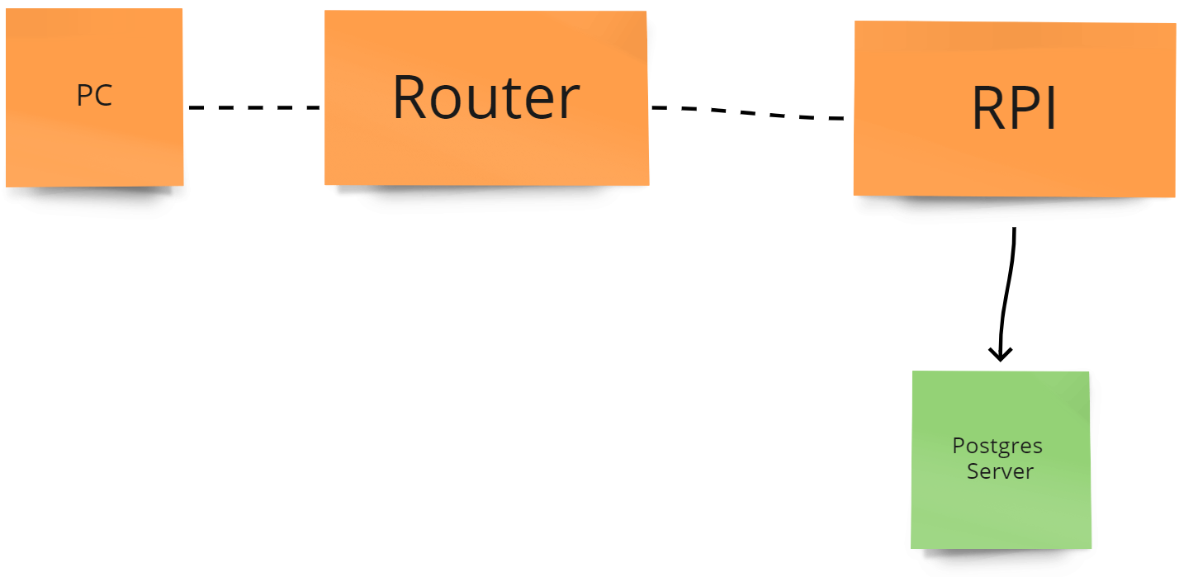
Data Analysis
Python script on PC
Retrieves last 200 measurements from DB
Loads into pandas DF
Use .Describe
Matplotlib to plot

Slide 10
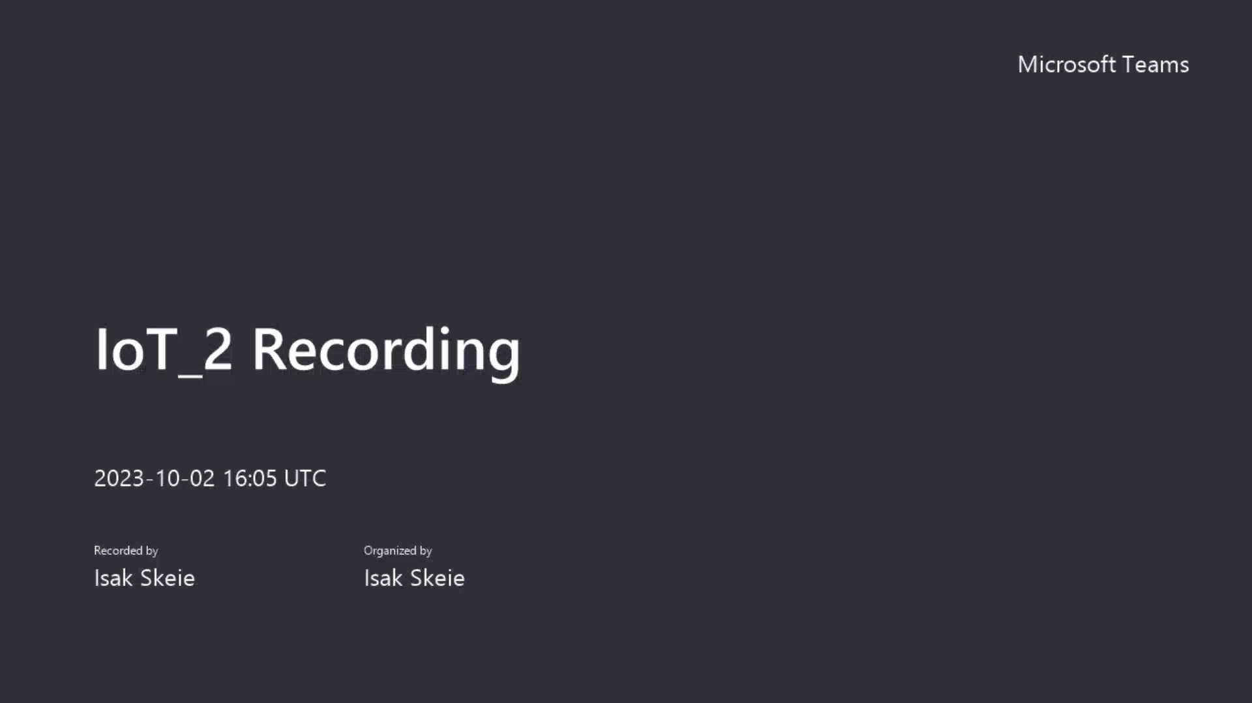

Slide 11
Cyber Security

